Slide 1
Data Analysis 201: Conquering the Dark Side of Excel
Barrie Fitzgerald—Valdosta State University
Dani Sutliff—South Georgia State College

Slide 2
Who are We?
Barrie Fitzgerald, Director of Institutional Research
Valdosta State University
Over 8 year in the data field with 6 in the IR field
Jack of all trades
Excel skill level around 8-9
Dani Sutliff, Director of Institutional Effectiveness & Research
South Georgia State College
7 years experience in IR
Whatever is needed of me…
Excel skill level around _____

Slide 3

Who are you?
Name
Title
Institution
Primary Duties
On a scale from 1 (low) - 10 (high), what is your skill level in Excel?

Slide 4
Interested in:
Ways to develop and hone in your skills as an analyst
Wanting to expand your knowledge of Excel formulas
At SAIR conference early
Required by your boss to attend

Slide 5
Learning Objectives
1.) Learn how to use advanced formulas.
2.) Lean how to combine advanced formulas.
3.) Learn how to create templates and other tricks to assist in updating reports.
4.) Learn how to create executive dashboards to assist with reporting to administration or external parties.

Slide 6

Objective One: Learn how to use advanced formulas.

Slide 7

Excel Workbook

Slide 8

Objective Two: Lean how to combine advanced formulas.

Slide 9

Excel Workbook

Slide 10

Objective Three: Learn how to create templates and other tricks to assist in updating reports.

Slide 11
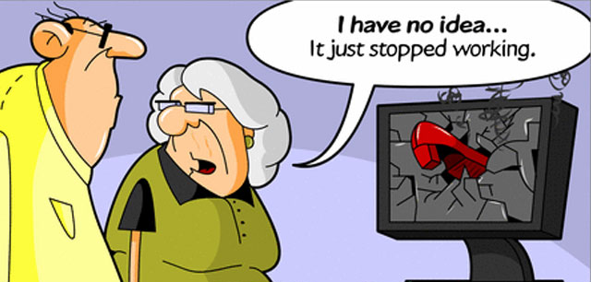
Why?

Slide 12
The Real Reason
Saves the following:
Time
Frustration and migraines
Formulas are correct
Available for the office to use
In case you leave or move on up
Last but not least: your computer

Slide 13
For?—Repetitive Publications
Fact Book, Newsletters, etc.
Provides information on a multitude of information and data to the public regarding the institution:
Enrollment and Graduation Trends
Employees
Finances
Libraries

Slide 14
Stairs to Heaven…I mean “Steps to Freedom”
1. Answer the following questions:
What is the publication?
Who is the audience?
What is the purpose?
What data needs to be presented?
How does it need to be presented?

Slide 15
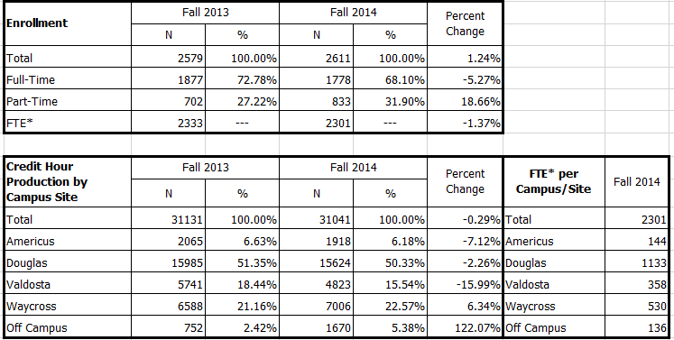
Stairs to Heaven…I mean “Steps to Freedom”
2. Create the Excel template
i. Charts
ii. Graphs
iii. Formulas (ensure these are accurate)

Slide 16
Stairs to Heaven…I mean “Steps to Freedom”
3. Create the Publisher template
a. Copy chart or table from Excel
b. In Publisher, select Paste in upper left hand corner
c. Select the arrow down button below Paste
d. Select Paste Special
e. Select Paste Link (Note: Microsoft Excel Chart Object Link should be highlighted)
f. Click ok

Slide 17
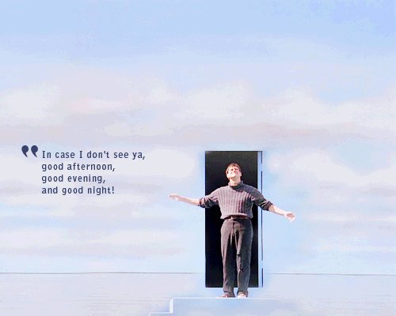
Stairs to Heaven…I mean “Steps to Freedom”
4. Once you have finished formatting and pasting, save!
5. Whenever you update Excel spreadsheet… no more copying and pasting!

Slide 18
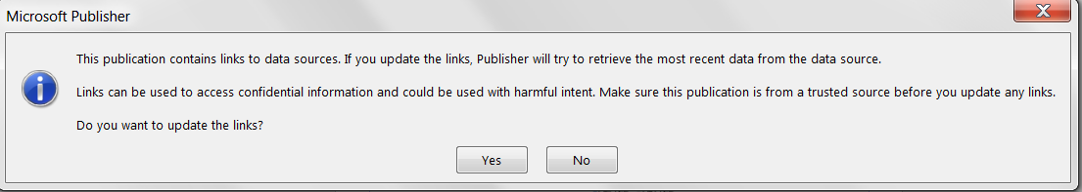
Stairs to Heaven…I mean “Steps to Freedom”
6. Open up Publisher document and you will see;
7. Click “Yes”—this will update all the data in the template
8. Finally, save the document!

Slide 19
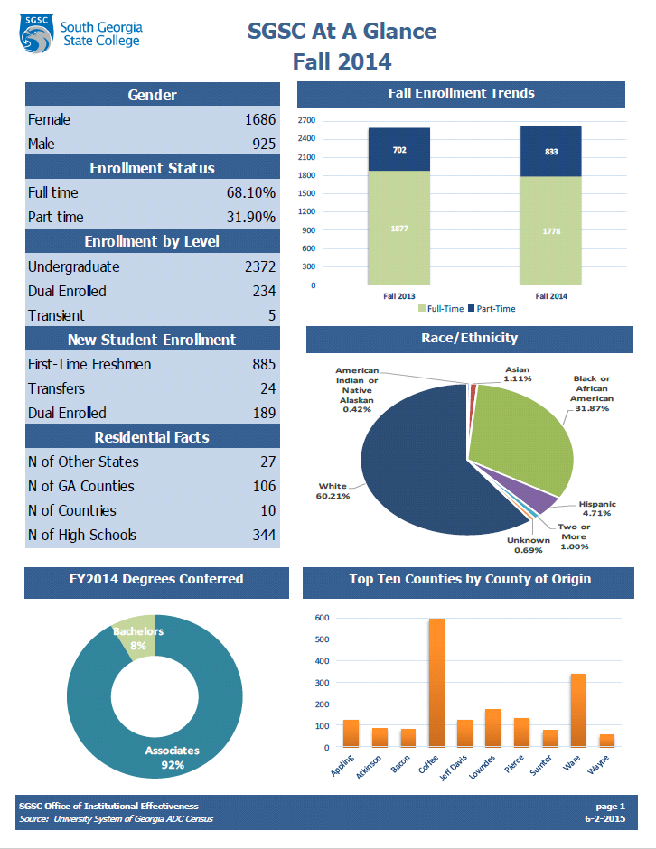
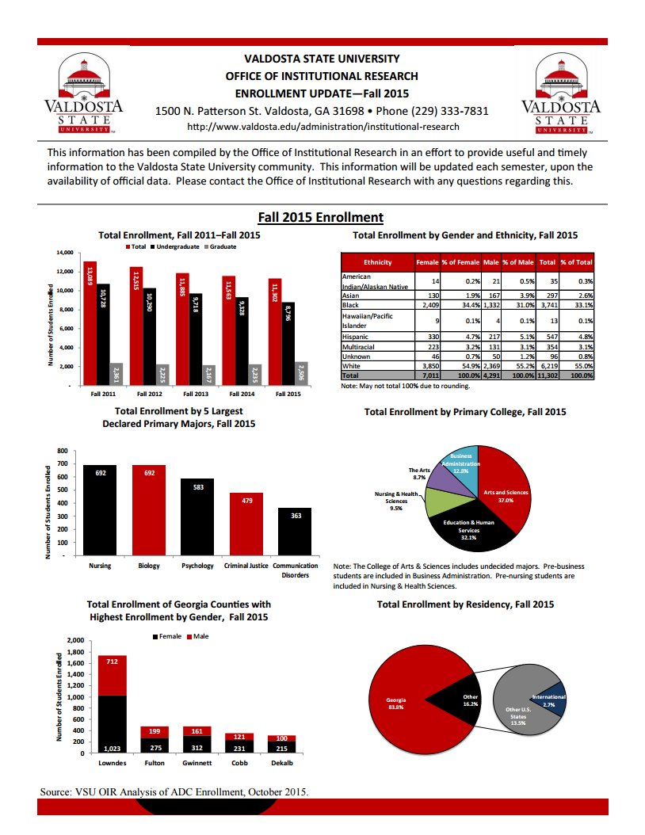
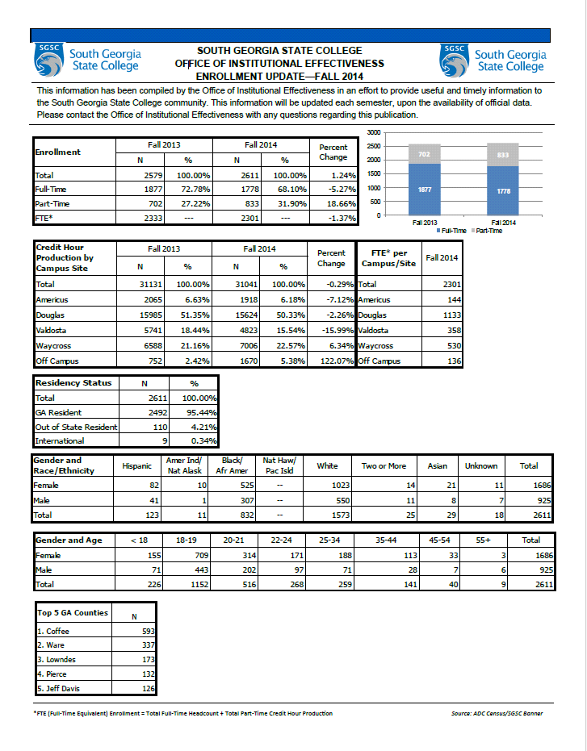
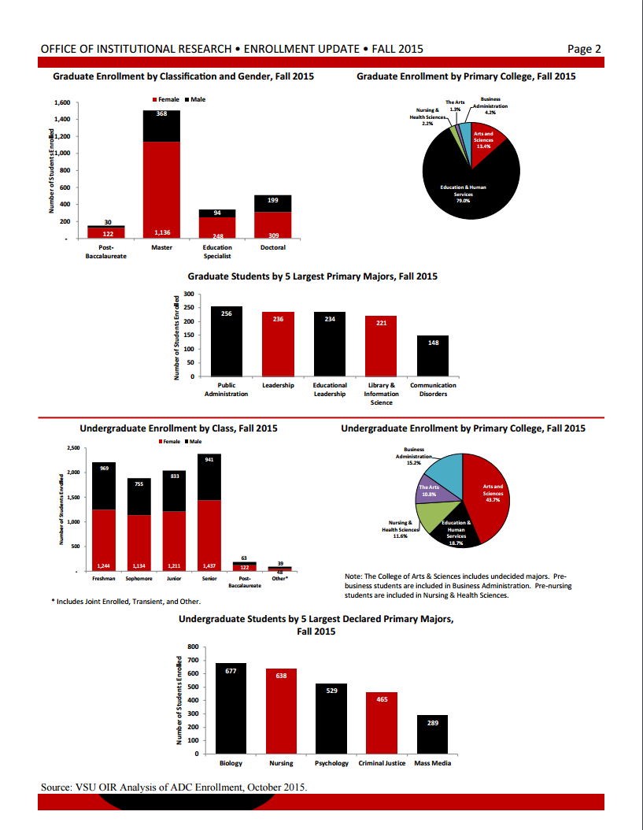

Slide 20

Objective Four: Learn how to create executive dashboards to assist with reporting to administration or external parties.

Slide 21

Why Excel “Dashboards?”
“Free” therefore cost-effective
Provides skyline view of data
Track multiple measures or KPIs in one place
Integrate multiple datasets
Easy to create

Slide 22
Things to Consider
Audience
Purpose
Don’t forget step one of data analysis
Security
Who will have access?
How will access be given?
Check with institution security policies

Slide 23
Which Data to Use?
National datasets (e.g. IPEDS, CUPA)
Local ERP (e.g. Banner, PeopleSoft, Jenzabar)
Census datasets
Combine multiple datasets

Slide 24
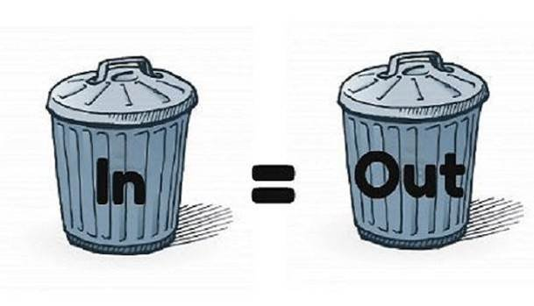
Basic Components
Follow data analysis steps—be sure the data is clean!!!
Pivot tables and charts
Filters
And your imagination!

Slide 25
Type of Connections
Internal
Excel files
External
Access
Web
Text files (csv)
Sql Server
ODBC Connection
XML
Other (any other file you can open in Excel)

Slide 26
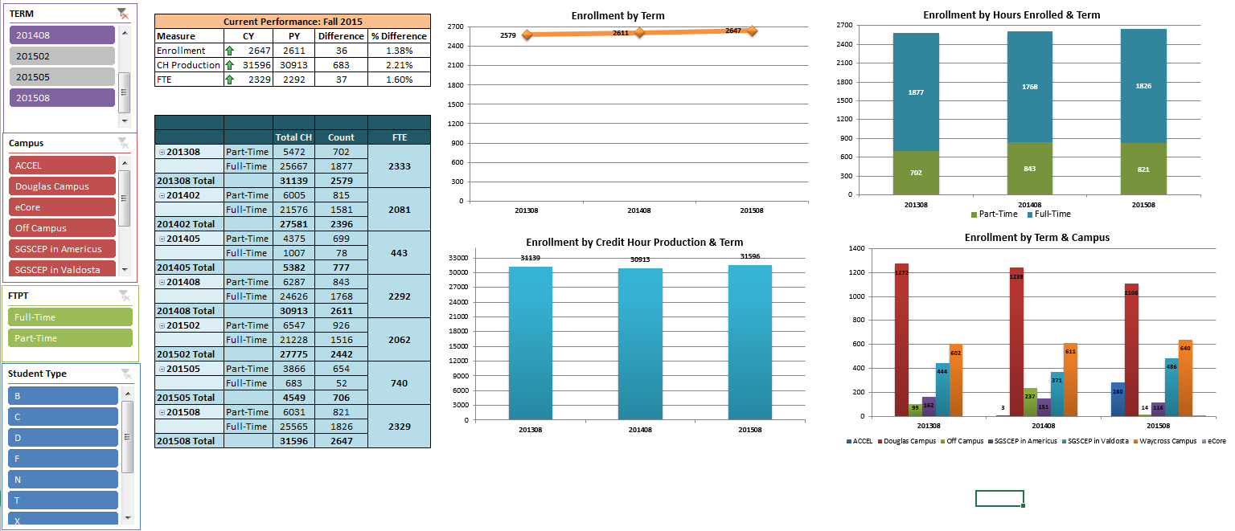
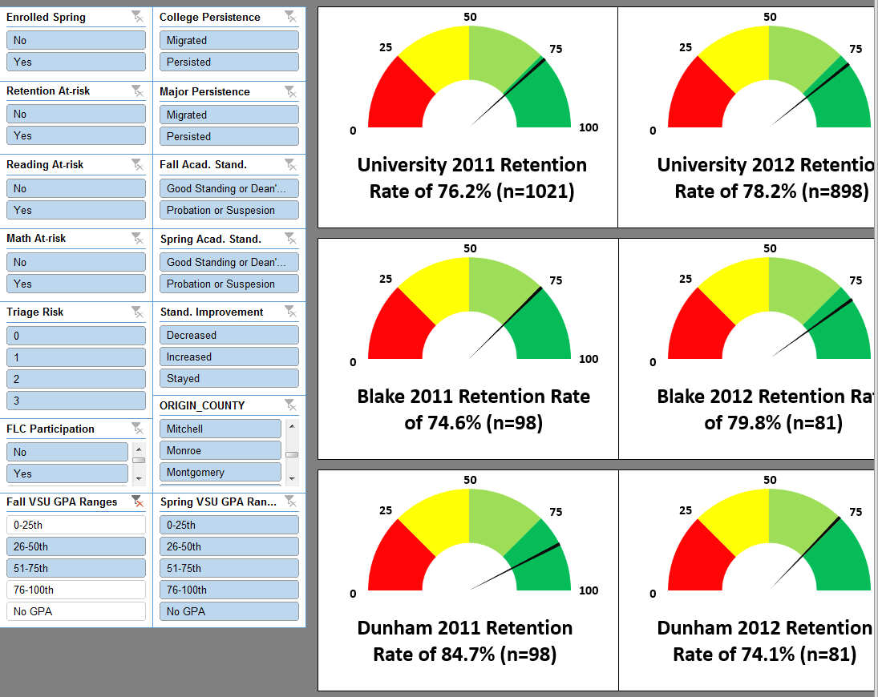

Slide 27
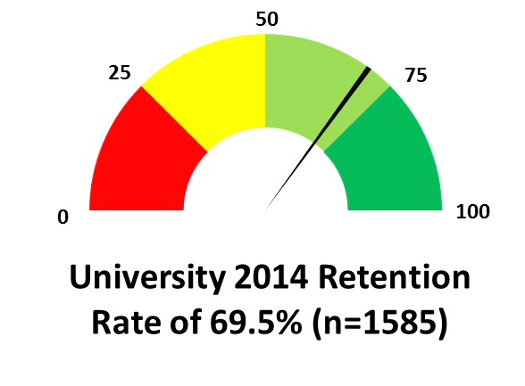
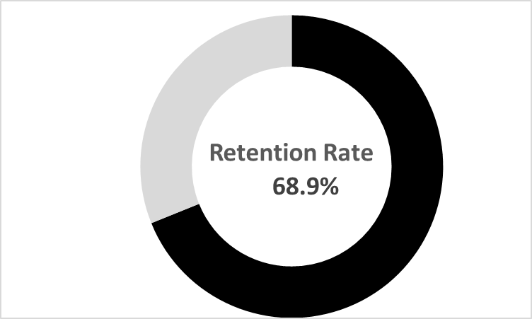
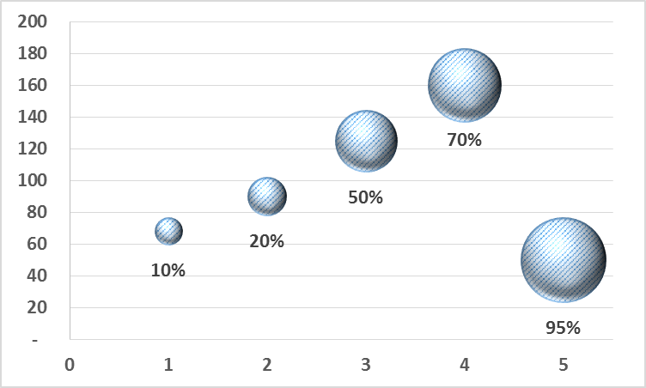
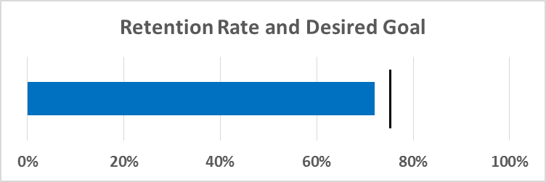
Unique and Creative Graphs

Slide 28





So How Do I Get One?

Slide 29
Barrie Fitzgerald
Director of
Institutional Research
Valdosta State University
229-333-7836
bdfitzgerald@valdosta.edu
Dani Sutliff
Director of Institutional
Research & Effectiveness
South Georgia State College
912-260-4419
dani.sutliff@sgsc.edu

Slide 30

Excel Workbook

